Slide 1
軽量トランスフォーマー・アンサンブルモーダル (Lightweight Transformer Ensemble Model ) を用いた自動運転車における 歩行者行動予測
電子機械類 知能制御プログラム
指導教員：Kamal Md Abdus Samad
T220G902 Nguyen Bao Viet

Slide 2
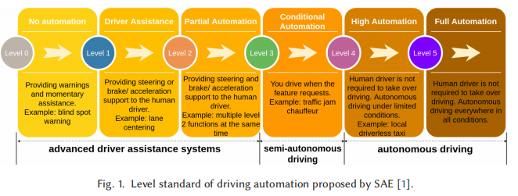
背景
自動運転はレベル1（運転支援）からレベル5（完全自動化）まで分類される。
レベル3以上では、常に人間の監視なしに車が交通状況が判断できる力が必要である。

Slide 3
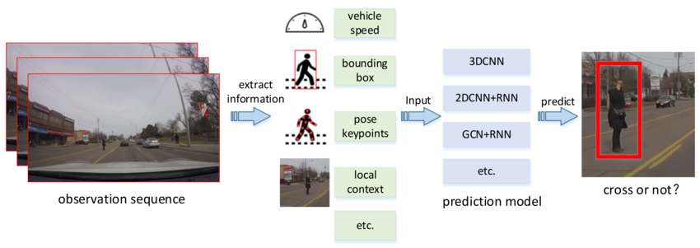
背景
そこで、大切な技術の一つは「歩行者行動予測」である。
これは、歩行者の動きや姿勢、周囲をもとに、横断、停止、方向転換などを予測する技術である。
Zhou, Xiao & Ren, Hongyu & Zhang, Tingting & Mou, Xingang & He, Yi & Chan, Ching-Yao. (2022). Prediction of Pedestrian Crossing Behavior Based on Surveillance Video. Sensors. 22. 1467. 10.3390/s22041467.

Slide 4
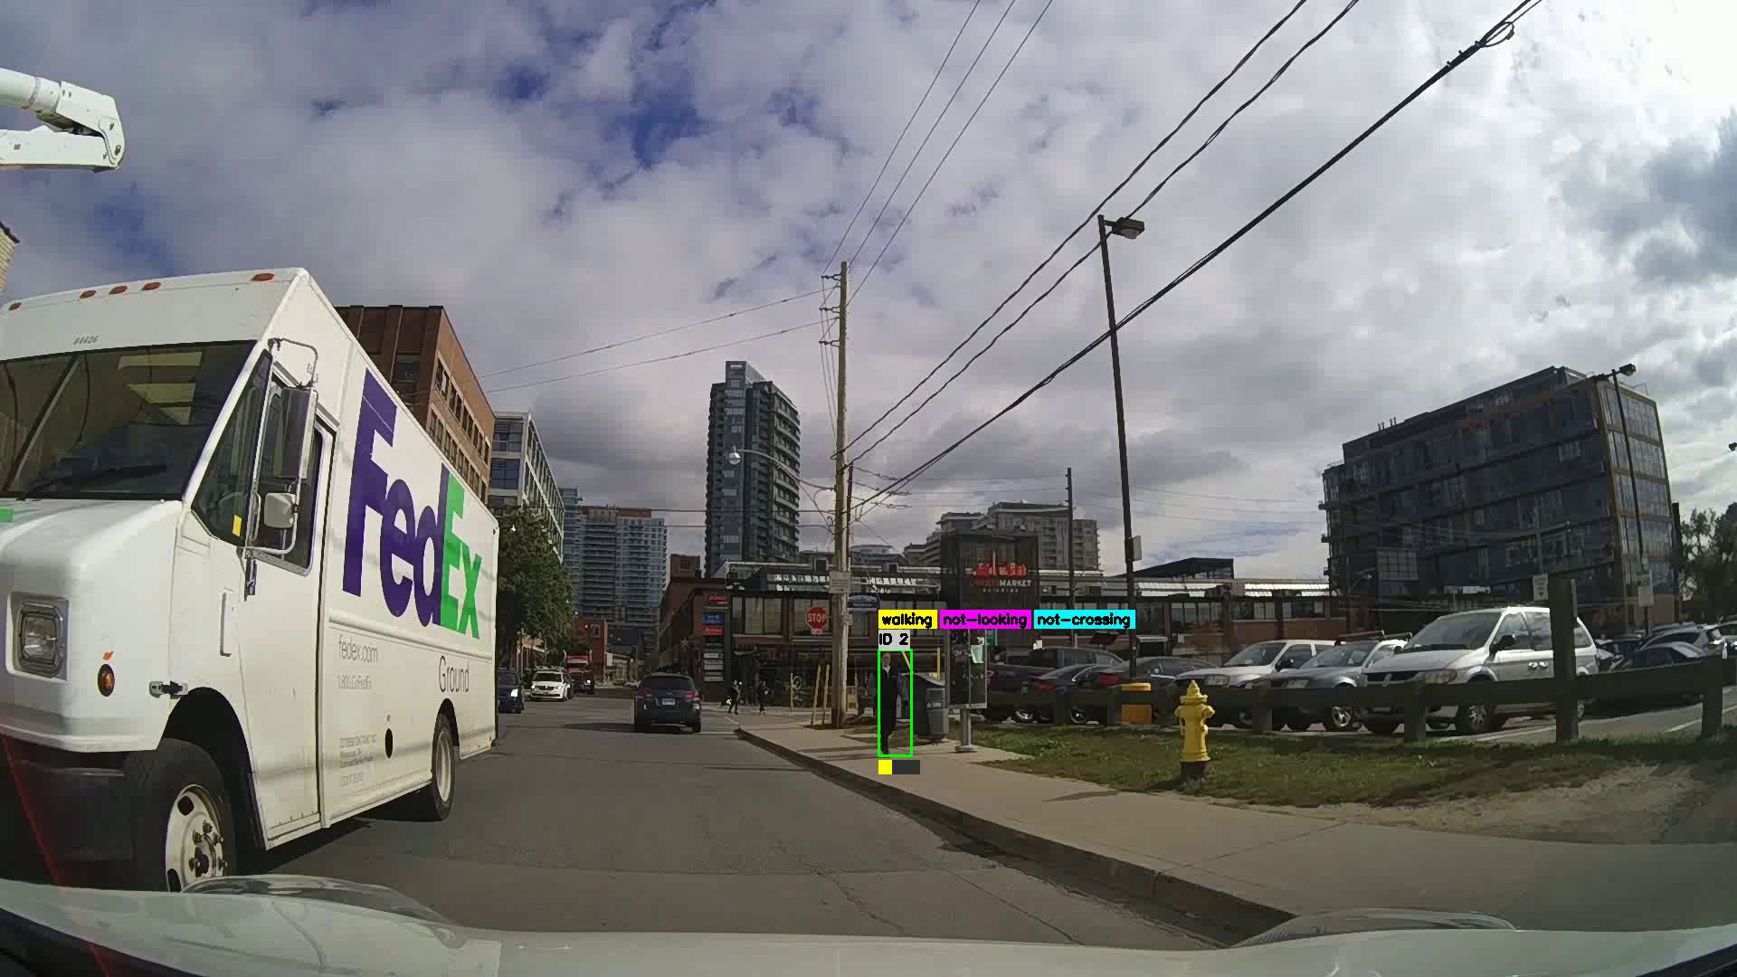

Slide 5
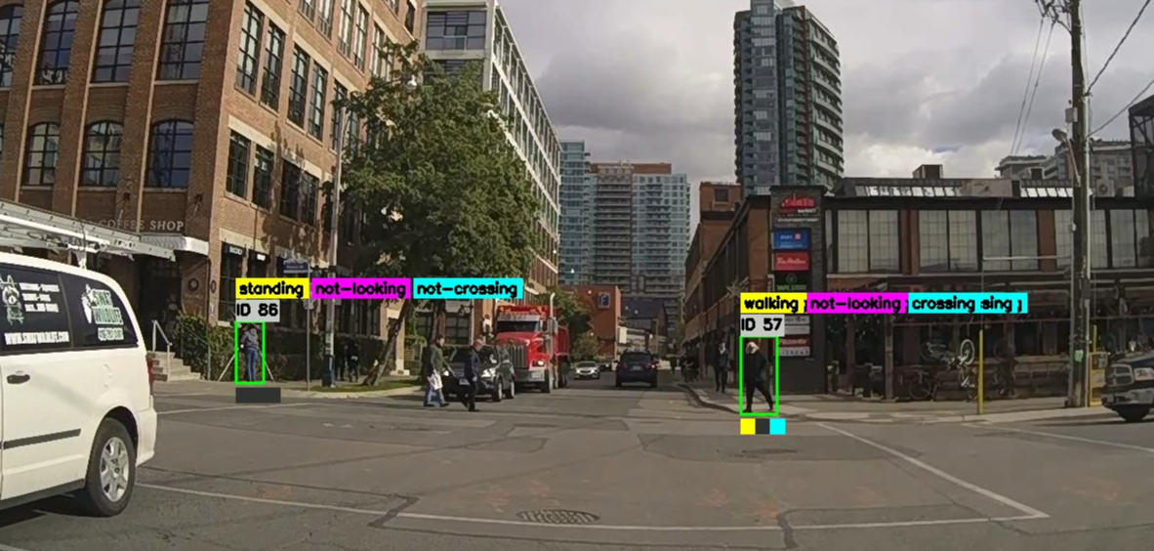
１秒後の予測ラベル
「徒歩」/「静止」
車に「見っている」/「見ってない」
「横断する」/「横断しない」/
「無関係」
この男性、また歩道にいるが、モデルは１秒後「横断」と予測する。

Slide 6
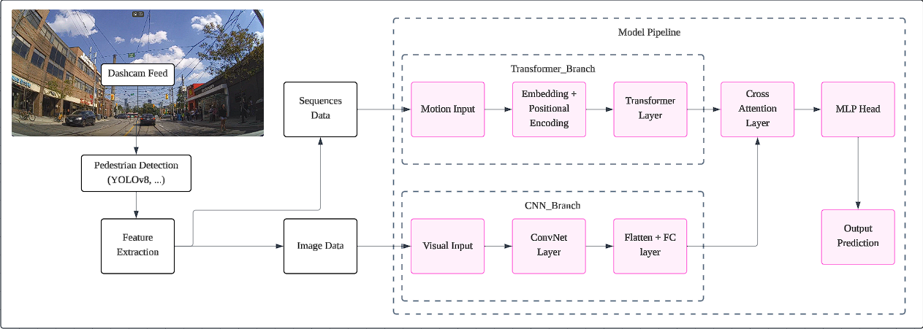
提案のモデル

Slide 7

This sucks, actually.
これ、まずい。

Slide 8
Why did it suck
1. Overpowered model for oversimplified input
過度に単純化された入力に対する強力なモデル
The Transformer branch received only low-level motion vectors: (x,y,dx,dy) sequences, which lacks the spatial–temporal richness Transformers are designed to model (no texture, shape, or high-dimensional structure).
As a result, the Transformer overfit easily, memorizing simple motion patterns instead of learning meaningful behavior cues.

Slide 9
Why did it suck
2. CNN backbone dominated the model
The CNN feature extractor (MobileNetV2 / EfficientNet-B0) held the majority of parameters and extracted strong semantic features almost independently.
The Transformer became more of a passive add-on.
In short：
I gave a complex Transformer too little to learn from, and handed too much responsibility to a frozen pretrained CNN.
複雑な Transformer に学習させる要素が少なすぎて、固定された事前トレーニング済みの CNN に任せきりになってしまいました。

Slide 10
Solution
Simpler backbone for low-level temporal data - Temporal Convolutional Network, LSTM, GRU, etc.
Utilize Transformer for high-level, feature-rich visual data -> Vision Transformer

Slide 11
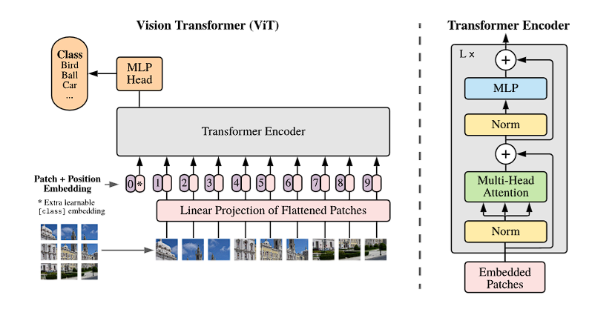
Vision Transformer
A Dosovitskiy et al, “An Image is Worth 16x16 Words: Transformer for Image Recognition at Scale”, 2021.

Slide 12
Vision Transformer
Paper / Model | Key Insights / Innovations | How It Informs Our Design
A Dosovitskiy et al, “An Image is Worth 16x16 Words: Transformer for Image Recognition at Scale”, 2021. | Treat images as patch sequences; flatten → linear embedding Use pure Transformer encoders, no convolution inductive bias | We adopted the patch embedding + transformer architecture as baseline.
Z Liu et al, “Swin Transformer: Hierarchical Vision Transformer using Shifted Window”, 2021. | Hierarchical design with patch merging between stages Local windowed self-attention + shifting windows | We borrow hierarchical staging and local window attention ideas.
C Ryali et al, “Hiera: a hierarchical vision transformer without the bells-and-whistles”, 2023 | Simplify hierarchical transformer: remove extra modules & biases Use MAE pretraining to let model learn spatial biases instead of hard-coding them | We follow the philosophy of simplicity, avoiding overly complex modules
Our Model | We combine hierarchical ViT with temporal branch, keeping design as minimal and interpretable as possible.

Slide 13
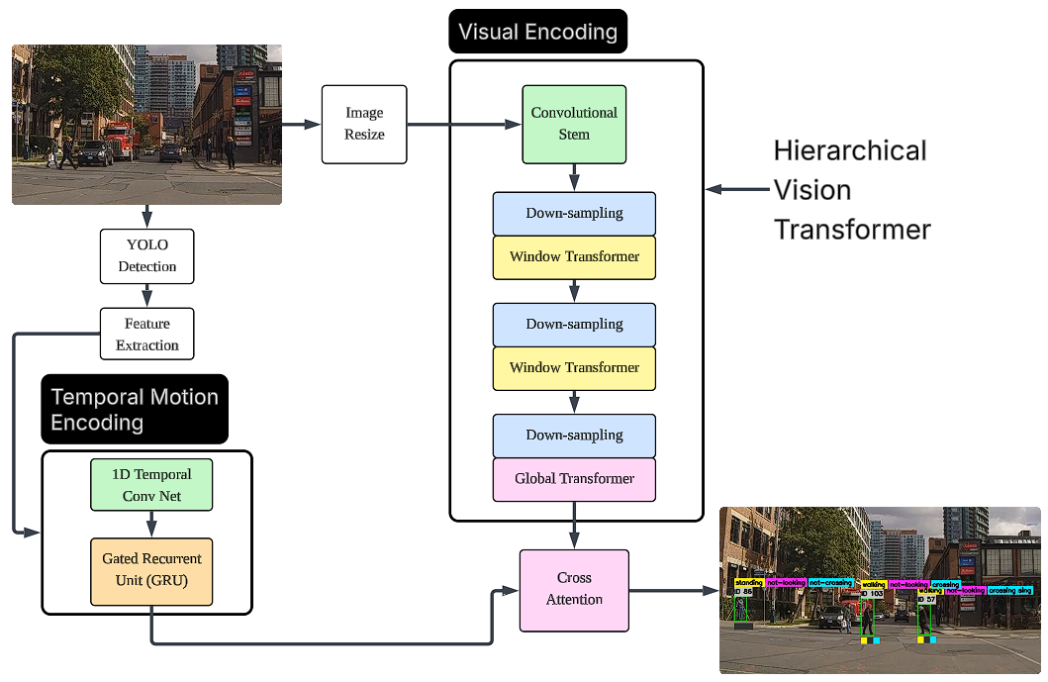
提案のモデル

Slide 14
Improvement
Temporal ConvNet + GRU handle motion data - simple, minimal computational weight, suitable for low-level data
Hierarchical Vision Transformer :
Hierarchical = multi-scale, captures both fine details and global context by gradually reducing spatial resolution.
Local window attention: efficient computation, reduce computational weight for lightweight implementation.
Cross attention mechanism: retain.
Parameter count approx. 5.6m <- this can be easily modified for balance research due to model scalability.

Slide 15
Initial Result
Accuracy / F1 score / ROC - AUC
Heads | Accuracy (%) | F1 | AUC
Actions | 60.94 | 0.64 | 0.66
Looks | 89.35 | 0.014 | 0.59
Crosses | 79.5 | 0.45 | 0.71
Overall | 76.6
PIE Dataset Benchmark Comparison:
Majority of research using the PIE dataset works on Binary Classification (Crossing/Not Crossing)
Primary PIE dataset baseline model reports 79.0% accuracy with F1 ≈ 0.87
Benchmark models’ accuracies vary, with SOTA (State of the Art) models reaching as high as 91 - 93% accuracy (Achaji et al., Is attention to bounding boxes all you need for pedestrian action prediction? (arXiv 2021); Yang et al., Predicting Pedestrian Crossing Intention With Feature Fusion and Spatio-Temporal Attention (IEEE T-IV 2022 / arXiv 2021))

Slide 16
What was that horrendous 0.014 F1 score???
Label count per prediction head
LABEL | 1 | 0 | -1
Actions | 27124 | 24831
Looks | 5034 | 46921
Crosses | 10075 | 40141 | 1739
Class Imbalance
Weak visual/temporal signal

Slide 17
Future plan
Data augmentation/model fine-tuning/architecture update
Preparing testing data.(done) Run multiple experiments for efficiency - accuracy balance testing.
Real time deployment experiments.

